Slide 1
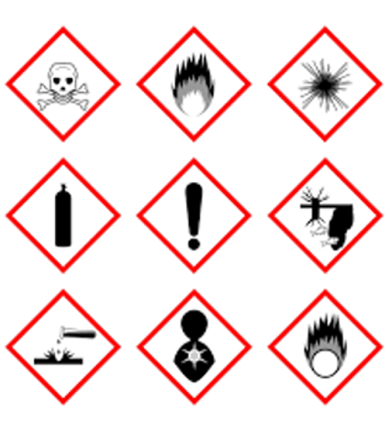
Chemical Management
User Guides:
CHEMICAL STORAGE AND COMPATABILITY
Issue 1.1: March 2025

Slide 2

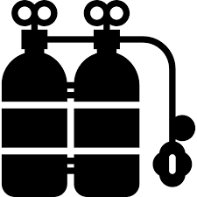
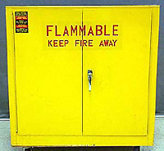


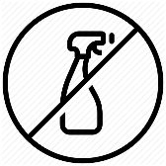

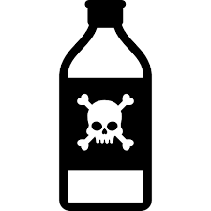

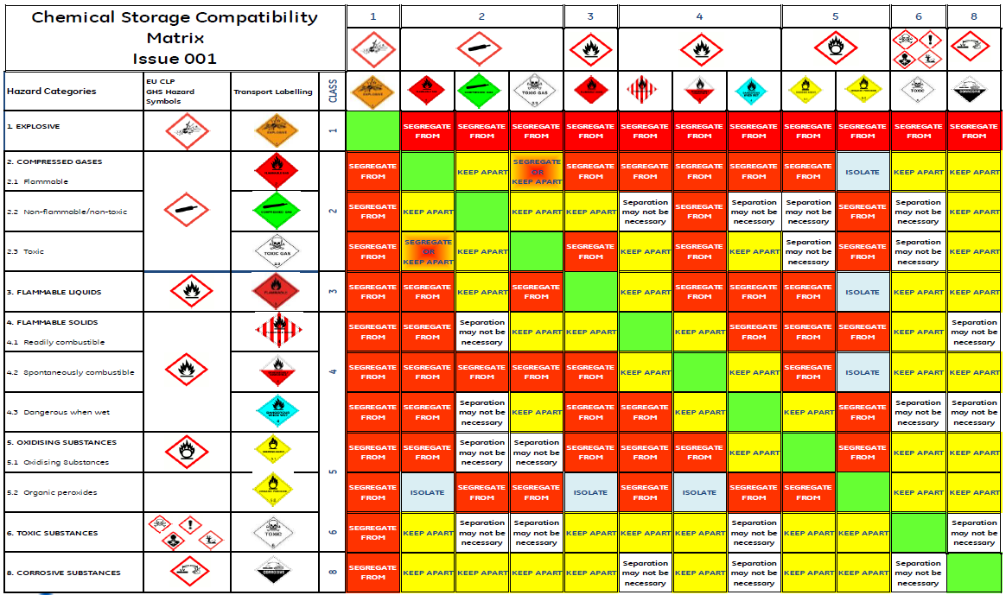
User Guide - Chemical Storage & Chemical Compatability
Bulk quantities of chemicals must be stored in areas separate from the work area.
Small quantities (aerosols, safety cans, secondary containers, etc.) may be stored in, or in proximity to the work area, so long as they are stored in proper containment devices, such as properly designed cabinets. WITH SECONDARY CONTAINMENT / BUNDING
Chemicals must be stored at the appropriate temperature (and humidity). As a rule, chemicals should not be stored near heat sources, such as steam pipes or heaters. Chemicals SHOULD NEVER be stored in direct sunlight, even for short periods.
Chemicals in storage should be labeled properly in accordance with Local regulation and manufacturers requirements.
Storage Areas should always undergo periodic visual inspections. Conditions to look for would include leaks, spills, seepage, bulging drums, labeling deficiencies, container deterioration, strong odors, AND incompatible material storage (see FieldCore compatibility matrix on page 3 & 4 of this guide)
Gas cylinders must be securely strapped to a permanent structure (wall, storage area, etc.). When they are not in use, they should be capped off to mitigate leakage and “rocket risk”. Compressed gas compatibility segregation usually is driven by separation of oxygen from other flammable gases such as acetylene, propane etc .
Chemicals should not be routinely “stored” in a work area. Only the amounts needed should be kept in the work area, and the remainder of materials kept in an approved storage locations for the site.
NEVER use water bottles to store chemicals, as this a potential accidental poisoning RISK!
Chemicals that are no longer used should be periodically purged (eg through ‘chemical’ sweep at fixed sites) from the site so as to minimize risks associated with such storage and in-plant inventory management.

Slide 3
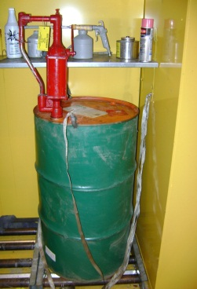
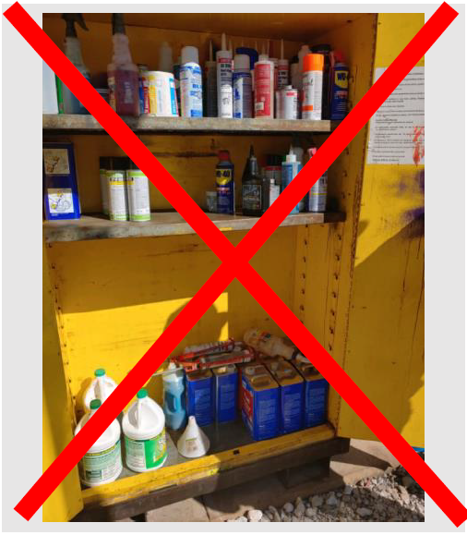
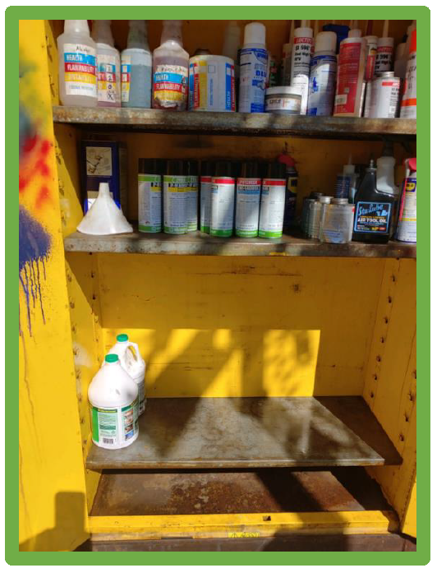
Flammable Storage Cabinets
Storing flammable liquids in fire resistant safety cabinets is a
simple way to reduce the risk of a damaging fire in the workplace
Some Best Practices^
Do not store brushes, rags, cardboard, or other combustible materials in cabinets
Do not store any materials on top of a flammable storage cabinet
Chemical Storage cabinets should not be place in direct sunlight or near head sources or high traffic areas
Immediately clean up any chemical spill in a cabinet so that it doesn’t evaporate/volatilize and possibly cause or add to a fire
DO NOT Store chemicals on the floor of chemical storage or flammable cabinets
^ Local regulation may differ or be more stringent
Cabinet must be labelled "FLAMMABLE—KEEP FIRE AWAY" legend or have the flammable “flame” icon.
Doors must have a 2 or 3 point latch and the door sill must be raised at least 2“/5cm above the cabinet bottom to retain spilled liquid within the cabinet.
Grounding and bonding is required for flammable cabinets containing chemical product being dispensed (or waste drums).
It is recommended that the maximum quantities that may be stored in cabinets and bins are no more than 50 litres / 11 gallons for extremely, highly flammable and those flammable liquids with a flashpoint below the maximum ambient temperature of the workroom/working area; and no more than 250 litres/55 gallons for other flammable liquids with a higher flashpoint of up to 55°C / 130°F.

Slide 4

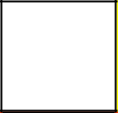
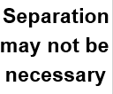








Chemical Compatibility Matrix – Key
Compatible
Refer to SDS and/or consult chemical suppliers – chemicals within same class e.g. Acids Corrosives (Class 8) may react violently, generate heat if mixed and or evolve toxic fumes.
Minimum 3 metres 10 Feet.
Not kept in the same building, compartment or outdoor storage compound.
Fire walls that are 30 minutes fire resistance of Brick or concrete construction recommended.
Organic peroxides – dedicated buildings are recommended.
Refers to outside storage of gas cylinders. Where non-liquefied flammable gases are concerned the 3 metres / 10 feet separation distance may be reduced to 1 metre / 3 feet.

Slide 5

Chemical Storage – Compatibility Matrix

